Slide 1

MapleCloud
Technologies Company Profile
Simplify Digital Transformation Globally

Slide 2
Table of contents
01
ABOUT OUR COMPANY
02
LOCATIONS
03
MCT PRODUCTS & SERVICES
04
DEVRAY [Born to Shine…]
05
DEVRAY PRODUCTS
06
CONTACT US

Slide 3
ABOUT US
MapleCloud Technologies is a (Cert-In Empaneled) information security firm that has made significant progress in the areas of IT Enablement and Cyber Security. We were one of India's top 50 information security firms. In Mumbai and Delhi NCR, where we are present, we assist our clients in meeting their business needs. With more than 20 years of combined experience, We offer industry-leading IT solutions and cost-effective services.

Slide 4
01
ABOUT OUR COMPANY

Slide 5
OUR HISTORY
ERP & CRM
Born to Shine…
2018
The Future
2014
2022
MCT
DevRay
Started working on ERP concepts and internal test & learn pilots using Odoo Platform.
MapleCloud Technologies was founded to address cyber security requirements for all sizes of businesses.
Developed DevRay Advanced Security And Surveillance Solutions

Slide 6
—Britney Hommertzheim
“As cybersecurity leaders, we have to create our message of influence because security is a culture and you need the business to take place and be part of that security culture.”

Slide 7
LOCATIONS AROUND THE WORLD
INDIA
Delhi, Mumbai
USA
Illinois
Dubai
Coming Soon…
These are the locations of all our offices

Slide 8

Vision - Simplify digital transformation globally

Slide 9

Mission
Enable industries a better place , one app at a time. We think business software should cover complex needs without being complicated. Our mission is to provide software that is intuitive, full-featured, tightly integrated, effortless to upgrade, all while running smoothly for every business, every user.

Slide 10
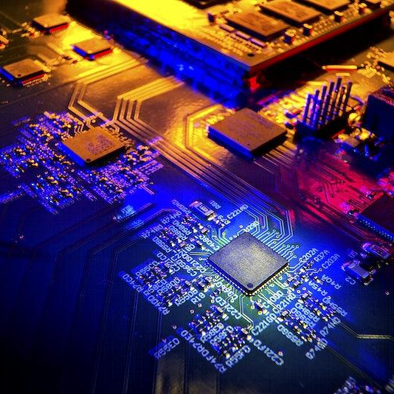
Digital Transformation is Business Transformation
Reviewing old business models, experimenting with new ones supported by leadership along with culture and change management.

Slide 11
02
MCT Products & Services

Slide 12
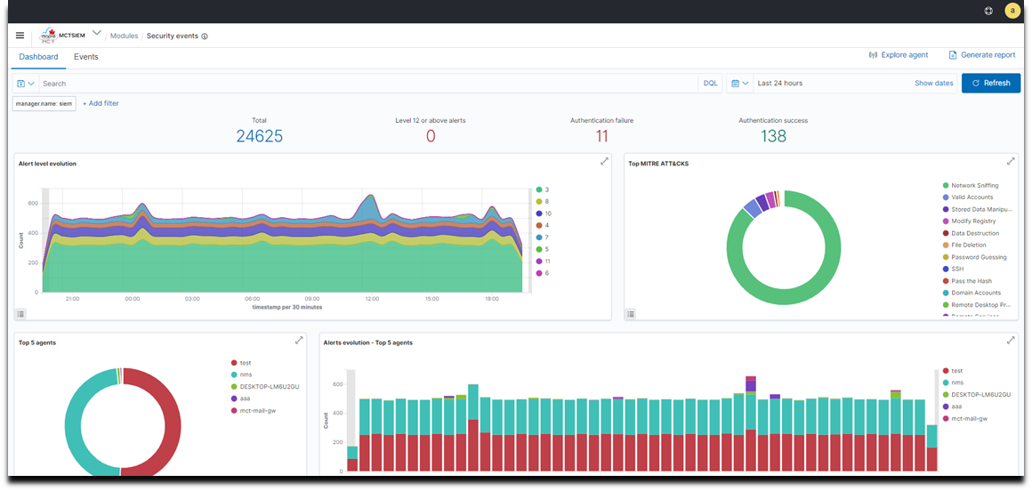
Security Information and
Event Management
MCT EVENTSHIELD
MCT EventShield solution consists of an endpoint security agent, deployed to the monitored systems, and a management server, which collects and analyzes data gathered by the agents providing a data visualization dashboard that allows users to navigate through their security alerts.
MCT EventShield also provides agentless monitoring of endpoints with the use of syslog protocol.

Slide 13

EventShield Features
EventShield Benefits
Log Data Analysis
File Integrity Monitoring
Configuration Assessment
Container Security
Vulnerability Detection
Security Events
Centralized Syslog Server
Rootkits Detection
System Inventory
Active Response
Enhanced Threat Protection
Log Management
Incident Response
Real-Time Alerts
Threat Intelligence
Compliance Reporting
Scalability
Customizable Rules and Policies
Centralized Visibility
Data Visualization
Customized Dashboards

Slide 14

Network Monitoring
System
MCT NMS
MCTNMS collects and reports on a variety of data from a computer network, including routers, switches, firewalls, load balancers and even endpoints, like servers and workstations. The collected data is filtered and analyzed to identify a variety of network problems like device failures, link outages, interface errors, packet loss, application response time, configuration changes.

Slide 15
MCTNMS Features
MCTNMS Benefits
Network Monitoring
Automated Discovery
Alarms
Events
In app & Push Notifications
Time Series Graph
Thresholds
Reporting Interface
Network Topology
Customizable Dashboards
Surveillance of Entire Network
Remote Data Collection – Custom Pollers
Data Collection
Manual/Automated Provisioning of Nodes
Performance Monitoring
Protocols availability Monitoring
SLA Monitoring & Reporting
Outages Report
Troubleshooting
Configurable
Security
Network automation
Nodes/IP Device Insights
Correlation
Trend Analysis
Geolocation
User/Admin-friendly
Event collection and processing: Event collection relies on Simple Network Management Protocol (SNMP) and syslog to collect network event data. Event processing is used to identify critical events, reducing the volume of alerts that network administrators must use to identify the root cause of the problems.
Network change and configuration management: Network change and configuration management (NCCM) archives network device configurations and can be used to automate configuration updates. Configurations may be retrieved and updated using any the command-line interface (CLI), Configuration analysis identifies day-to-day changes and audit compliance exceptions where configurations don't match network design policies.
Telemetry: Devices and monitoring systems may employ network telemetry to push network performance data to a network monitoring system. Some network monitoring systems and related network devices use representational state transfer interfaces to collect data using these same data formats.

Slide 16
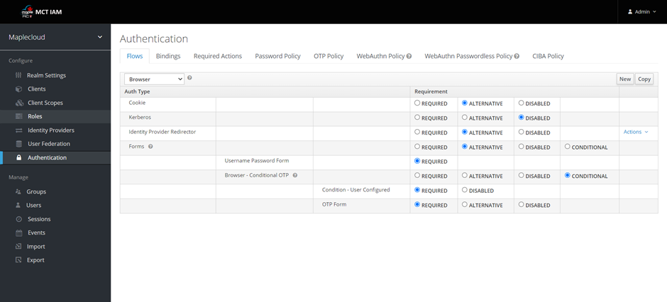
Identity & Access Management
MCT IAM
IAM stands for Identity and Access Management. It is a framework of policies, technologies, and processes that ensure that only authorized individuals have access to an organization's systems, applications, and data. The main objective of IAM is to provide a secure and efficient way to manage identities, authentication, and authorization for both internal and external users.
IAM systems typically include several components, such as:
Identity Governance: This component is responsible for managing user identities, provisioning and de-provisioning of user accounts, and enforcing security policies.
Authentication: This component is responsible for verifying the identity of a user who is attempting to access an application or system.

Slide 17

MCTIAM Features
MCTIAM
Benefits
Single sign-on (SSO)
Social login integration
Multi-factor authentication (MFA)
User federation
Authorization and permissions management
Identity brokering
OpenID Connect and OAuth 2.0 support
Fine-grained password policies
User self-service
Enhanced Threat Protection
Log Management
Incident Response
Real-Time Alerts
Threat Intelligence
Compliance Reporting
Scalability
Customizable Rules and Policies
Centralized Visibility
Data Visualization
Customized Dashboards

Slide 18

MCT EGS
MCT Email Gateway Solution
MCT Email Gateway is a full-featured mail server solution that simplifies the process of setting up and managing email services for businesses and organizations. It offers a comprehensive email infrastructure, including support for popular email protocols such as IMAP, SMTP, and POP3, as well as webmail interfaces. It has multiple mail transfer agents, spam filters and virus filtering tools. Additionally MCT Email Gateway supports multi-domain and multi-language setups, making it suitable for both small businesses and large enterprises seeking a reliable and customizable email server solution.

Slide 19

MCT EGS Features
MCT EGS
Benefits
Email Multi-Protocols Support: Webmail Interfaces
Multi-Domain Support
Multi-Language Support
Security Features
User and Domain Management
Storage Options
Backup and Restore
Clustering and High Availability
Integration with External Services
Automated Updates
Mobile Device Compatibility
Logging and Monitoring
Ease of Management
Comprehensive Email Services
Security Features
User-Friendly Webmail
Flexibility
Scalability
Compatibility
Data Privacy and Control

Slide 20

Patch Management
MCT Patch Management
The software solution is designed to streamline and automate the process of updating and securing your computer systems. With its user-friendly interface and robust features, it simplifies the management of software patches and ensures that your systems remain protected against vulnerabilities, all while saving you valuable time and resources. The tool is designed to stay ahead of the curve and safeguard your digital assets with our exceptional patch management tool.

Slide 21

MCT PM Features
MCT PM
Benefits
Multi-Platform Support
Automated Patch Scanning
Centralized Dashboard
Patch Deployment Automation
Patch Testing
Customized Policies
Compliance Tracking
Patch Rollout Control
Patch History and Auditing
Patch Repository
Enhanced Security
Automated Updates
Reduced Downtime
Improved Compliance
Efficient Resource Utilization
Risk Mitigation

Slide 22
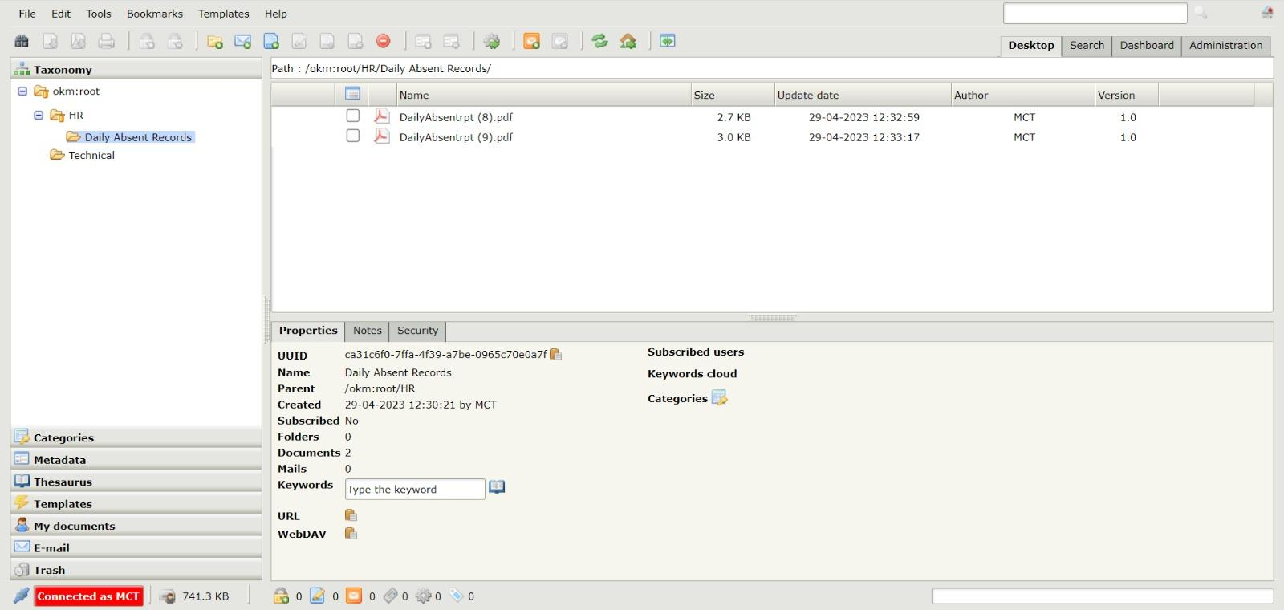
Document Management System
MapleDoc
MapleDoc is a web-based Document Management System (DMS) that provides a platform to manage the complete lifecycle of documents, from creation to archiving, versioning and record keeping. It allows users to collaborate on documents, share knowledge and improve productivity.

Slide 23

MCT MapleDoc Features
MCT MapleDoc
Benefits
Reduced time spent on processing files
Easy access to data improves communication within the organization and decision making
Manage the entire life cycle of your organizational documents from upload, retrieval to sharing
Convenient storage and retrieval of files
Loss of files are excluded
Manages the workflows of different department based on organization needs
Versioning of files in DMS can help Management to better track a document with no documents pile up.
Document Management
Workflow Management
Knowledge Management
Security Management
Integrations
Audit Trail
Email Management
Records Management
Reporting
Mobile Access

Slide 24

Security Offerings
Consulting
Implementation & Support
Cloud Migration
More than 2 decade of experience in providing consulting services to meet cyber security requirements. Key Consulting Services are:
IT Audit & Compliance (ISO 27001, PCI-DSS, HIPAA, SOX etc.
Organization Maturity Review
VA/PT & Application Code Review
Security Incident Response
Cyber Forensic
Cloud Assessment
We have designed and implemented IT & Security Infrastructure for following industries:
Mission Critical Project.
Defence Sector
Energy Sector
Telecom Sector
Manufacturing Industry
BFSI
HealthCare Sector
IT/ITES sector
We provide range of services such as:
Hyper Converged Infrastructure
Server Virtualization
Software Defined Storage
Enterprise Backup and Recovery
Data Replication – Physical, Virtual Database
Dr Automation
Server Consolidation
Cloud Assessment

Slide 25

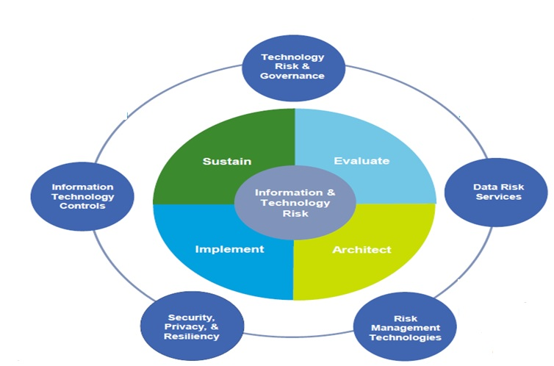
Security Offerings
IIT Risk Advisory Services
T Governance
IT Integrated Compliance
Security Strategy & Transformation
Security GRC/Metrics
Vulnerability Management
IT Asset Management
Third Party Security
Data Privacy
Information Leakage
Identity & Access Control System
Business Continuity Management/ Disaster Recovery Planning
People Risk Assessment
Training & Awareness
PCI Data Security
Security Incident and Event Management (SIEM) & Security Operations (SOC)
Application Integrity
Secure Development Lifecycle
Independent Verification & validation
Cyber Security
Forensic Services
Cloud Computing
Mobile Security
Managed Risk Services
Perimeter Security:
Core Switch's
Proxy Bluecoat
Firewall
WAF
IPS
DDOS
Hybrid Cloud Security
perimeter Security
Network Security:
Email Gateway Protection
Email DLP
Network Access Control
Privileged ID Management
SIEM (Log Management and Co-relation)
APT
Cloud Security, ZIA, ZAP
NAC
Endpoint Security:
Endpoints AV, HIPS, DLP, MDM
Encryption, Policy Compliance
Servers – HIPS, AV, Policy Compliance
FIM (File Folder Integrity Monitoring)
IAM (identity and access management
PIM (Privileged identity management)

Slide 26





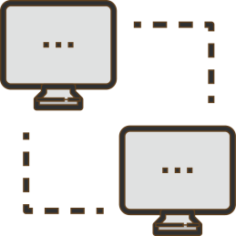
Cloud Service Portfolio
Consulting
Vendor/DCSP assessment
RTO/RPO assessment
Link/Connections
Risk Assessment and mitigation
Downtime and Migration plan
Infra optimization consulting w.r.t on premise, outsourced standpoint
Azure
AWS
DC Set Up
PaaS: Platform-as-a-Service
Location and facility Assessment
(Optional)Near DC assessment
Migration Setup & Systems Integration
Remote infra managed services
Ownership of hardware lifecycle management including refresh
Azure
AWS
Google
IaaS: Infrastructure-as-a-Service
HP
BMC
Salesforce
SaaS: Software-as-a-Service
Remote Infra
Managed Services
KT of existing managed services model.
Procurement/adherence to tools, licenses, etc @ NOC
Infra services configuration
Transition to NOC
Proactive health support and incident management
DR Set Up
Location and facility Assessment
(Optional)Near DR assessment
Recovery solution Setup
Storage solution Setup
Tape vaulting features

Slide 27

04
Born To Shine…

Slide 28

ABOUT US
DevRay promises to provide you with the most cutting-edge and recognisable CCTV surveillance systems that can integrate massive amounts of data to provide valuable and insightful information. Users may do advanced inspection, analysis, interpretation, and management thanks to the systems. They support the speedy and intelligent deployment of security system solutions by conducting thorough analyses depending on the position and location of the device. Videos are now the fastest-growing data category due to their capacity to boost productivity and the effectiveness of search capabilities. With the aid of our video management systems, which have the unique ability to give recorded data with outstanding precision, you may use surveillance video data for security. Use our technologies to stop loss at every stage or whether you just want to learn more about the trends in your shop and the purchasing patterns of your consumers. You may also make use of our robust and efficient video search feature to make it easier to recognise particular criteria like licence plate numbers, the characteristics of items, face photos, etc.

Slide 29

DevRay
05
Products

Slide 30
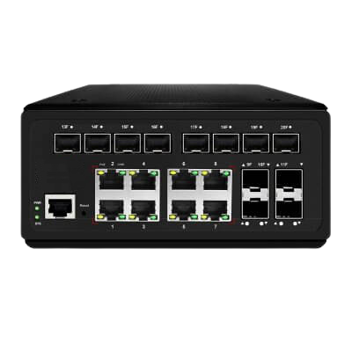
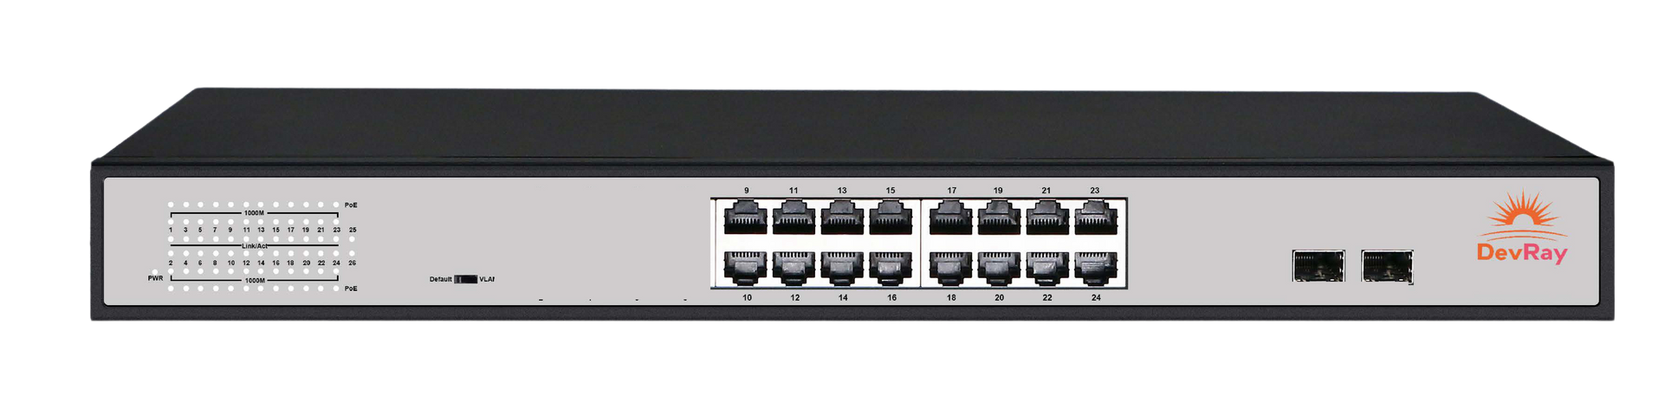
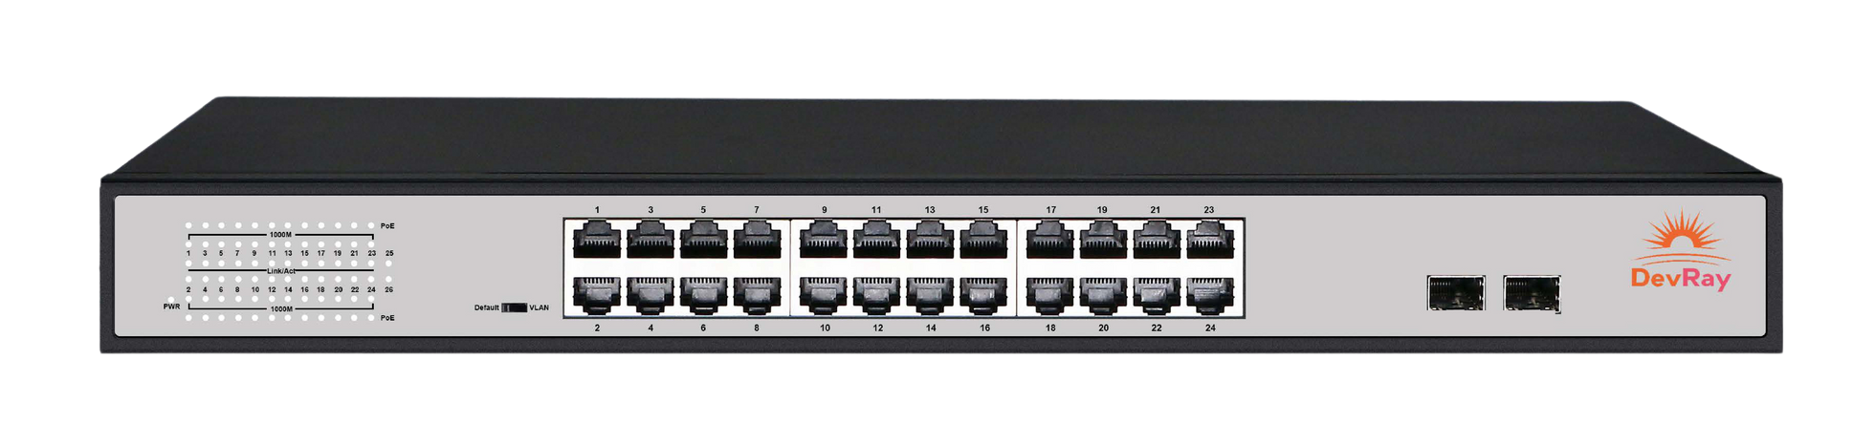
DevRay SWITCHES
Unmanaged PoE Switch
16x1000m PoE + Gigabit SFP
Unmanaged PoE Switch
24x1000mM PoE + 2x Gigabit SFP

Slide 31
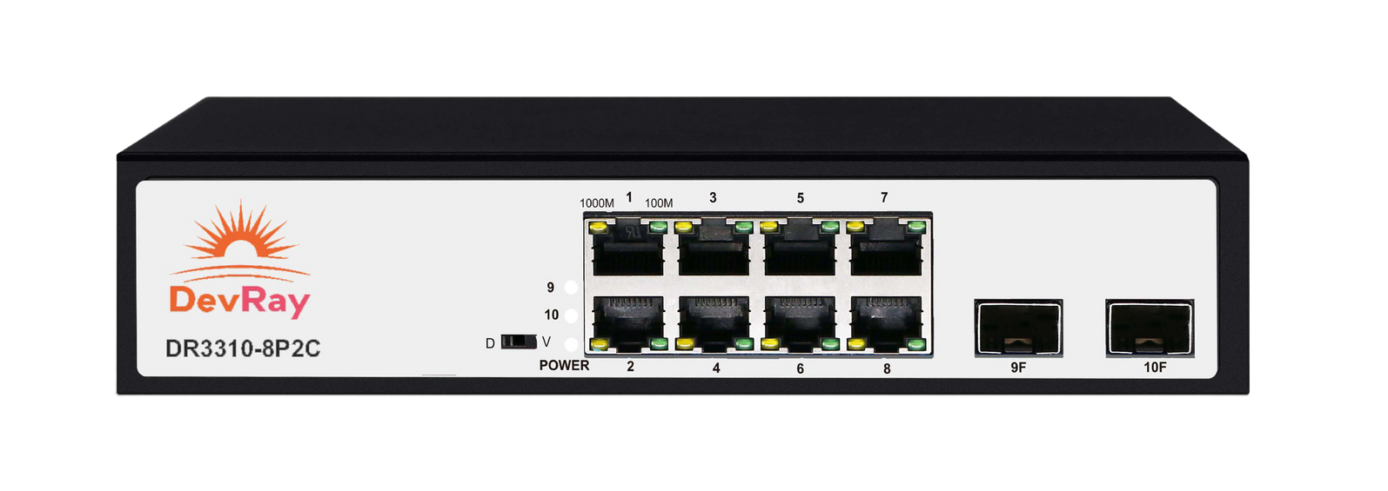
DR3000 Series Enterprise UnmanagedPoE Switch
DR3310 -8P2C
DR3318 -16P2C
Unmanaged PoE Switch
16x1000m PoE + Gigabit SFP
Features
Realtek main chip guarantee stable performance.
8*10/100/1000M PoE ports with 2 gigabit SFP ports for various application
Port 1 support 60W Hi-PoE output, 2-8 ports support up to 30W PoE output
Support unmanaged PoE PD-alive function,reboot frozen PD devices automatically
Support CCTV, VLAN, Default working modes
Support 9K jumbo frame
LED indicator on front panel for working status and fault analyzing
Plug-and-play design,easy for installation
Certification: CE, FCC RoHS
Features
Realtek main chip guarantee stable performance.
16*10/100/1000M PoE ports with 2 gigabit SFP ports for various application
Standard AF/AT PoE output, up to 30W per port
Support Default , Flow Control and VLAN workingmodes
Support 9K jumbo frame
LED indicator on front panel for working status and fault analyzing
Plug-and-play design,easy for installation
Certification: CE, FCC RoHS

Slide 32
DR3000 Series Enterprise UnmanagedPoE Switch
DR3326 -24P2C
Unmanaged PoE Switch
24x1000mM PoE + 2x Gigabit SFP
Features
Realtek main chip guarantee stable performance.
24*10/100/1000M PoE ports with 2 gigabit SFP ports for various application
Standard AF/AT PoE output, up to 30W per port
Support Default,Flow Control and VLAN working modes
Support 9K jumbo frame
LED indicator on front panel for working status and fault analyzing
Plug-and-play design,easy for installation
Certification: CE, FCC RoHS

Slide 33
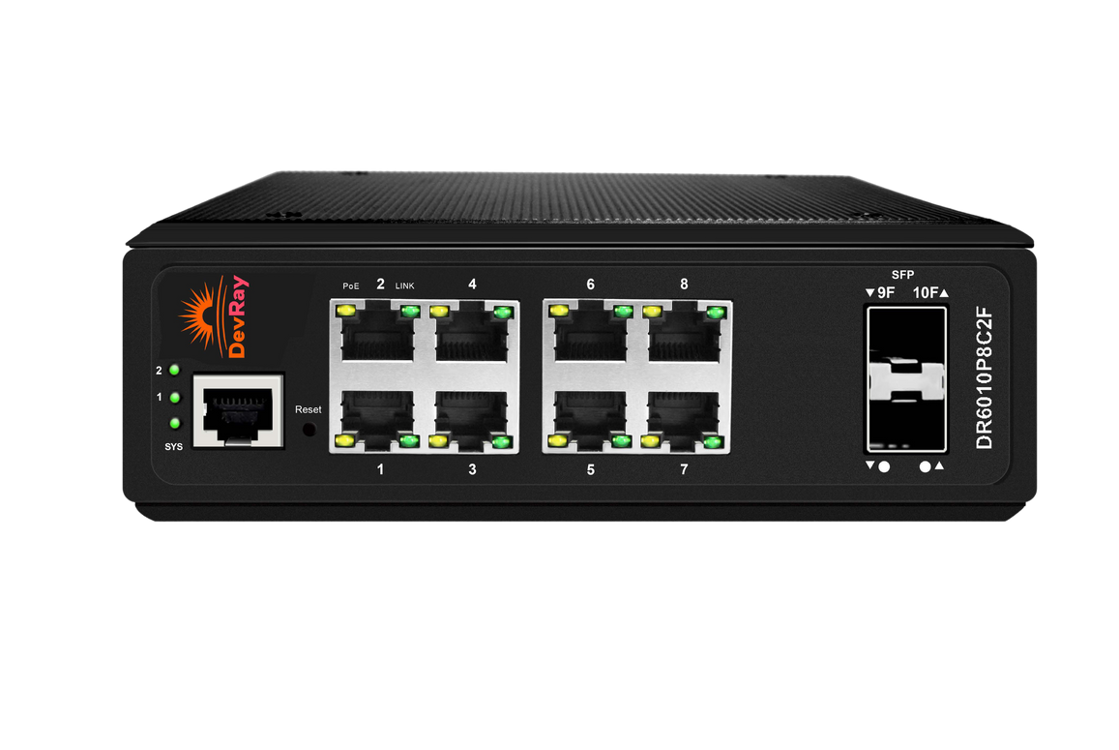
DR6000 series Industrial Managed POE Switch
DR6010P8C2F
DR6020P16C4F
Features
Support L2+ Switching features including 802.1Q VLAN, Mirroring, IGMP Snooping, DHCP Snooping,LLDP, PoE management, IP Source Guard, ARP inspection, ACLs etc.
Support spanning tree STP(802.1D) and RSTP(802.1W) and MSTP(802.1s)
Support enhanced management through WEB, CLI, TELNET, SSH, SNMP.
Dual firmware backup mechanism
Support PoE management, like PoE schedule,PoE PD-alive, Port PoE Priority, Soft - Reboot PoE Non-stop
Support G.8032 quick ring protocol. Self-recovery time <20ms
Support IEEE1588v2, transparent clock(TC);
support IPV4/IPV6static routing functions
Support cable diagnosis, DDM, SFP digital diagnostics monitoring
Support memory and CPU monitoring
Features
Support L2+ Switching features including 802.1Q VLAN, Mirroring, IGMP Snooping, DHCP Snooping,LLDP, PoE management, IP Source Guard, ARP inspection, ACLs etc.
Support spanning tree STP(802.1D) and RSTP(802.1W) and MSTP(802.1s)
Support enhanced management through WEB, CLI, TELNET, SSH, SNMP.
Dual firmware backup mechanism
Support PoE management, like PoE schedule,PoE PD-alive, Port PoE Priority, Soft - Reboot PoE Non-stop
Support G.8032 quick ring protocol. Self-recovery time <20ms
Support IEEE1588v2, transparent clock(TC);
support IPV4/IPV6static routing functions
Support cable diagnosis, DDM, SFP digital diagnostics monitoring
Support memory and CPU monitoring

Slide 34
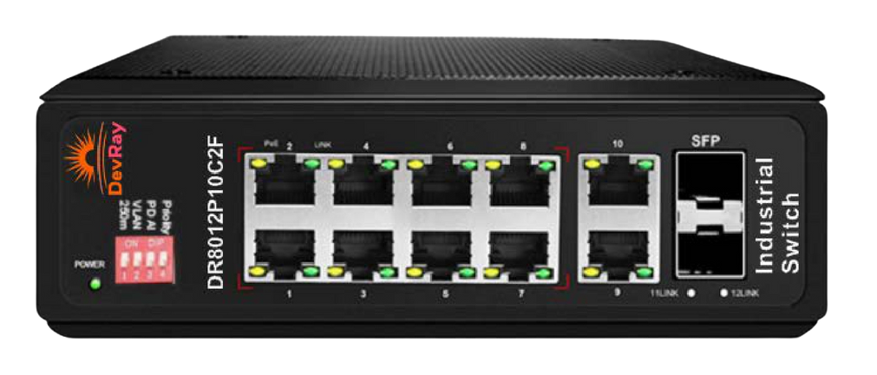

DR8000 series Industrial Unmanaged PoE Switch
DR6020P16C4F
Features
Support IEEE802.3x flow control for Full-duple mode and back pressure for Half- duplex mode,RJ-45 port supports Auto MDI/MDI-X;
Support unmanaged PoE PD-alive function, reboot frozen PDs automatically.
Support CCTV (250M) and VLAN working modes
Support port PoE priority as following: Port 1> Port 2>...> Port 8
Wide voltage input: 48V-57V
Redundant power design, support power hot backup;
Wide working temperature: -30℃ to +65℃

Slide 35
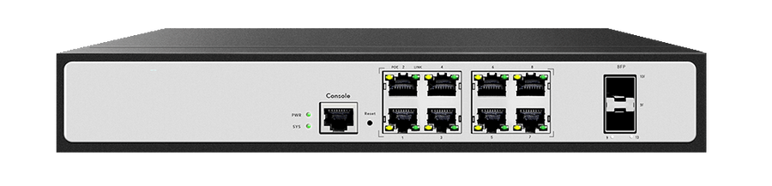
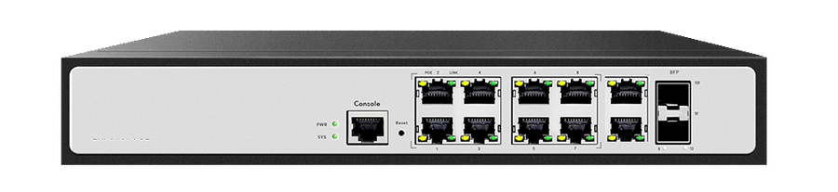
DR7000 series Enterprise Managed PoE Switch
DR7010P8C2F -HP
DR7012GCF
Features
Support L2+ Switching features including 802.1Q VLAN, Mirroring, IGMP Snooping, DHCP Snooping,LLDP, POE management, IP Source Guard, ARP inspection, ACLs etc.
Support enhanced management through WEB, CLI, TELNET,SSH, SNMP.
Support cable diagnosis and SFP DDM.
Support PoE management, like PoE schedule, PoE PD-alive.
Support G.8032 quick ring protocol. Self-recovery time <20ms.
Support IEEE1588v2, transparent clock(TC)
Support DDM, SFP digital diagnostics monitoring
Support IPV4 and IPV6 static routing functions
Support memory and CPU monitoring
Features
Support L2+ Switching features including 802.1Q VLAN, Mirroring, IGMP Snooping, DHCP Snooping,LLDP, POE management, IP Source Guard, ARP inspection, ACLs etc.
Support enhanced management through WEB, CLI, TELNET,SSH, SNMP.
Support cable diagnosis and SFP DDM.
Support PoE management, like PoE schedule, PoE PD-alive.
Support G.8032 quick ring protocol. Self-recovery time <20ms.
Support IEEE1588v2, transparent clock(TC)
Support DDM, SFP digital diagnostics monitoring
Support IPV4 and IPV6 static routing functions
Support memory and CPU monitoring

Slide 36
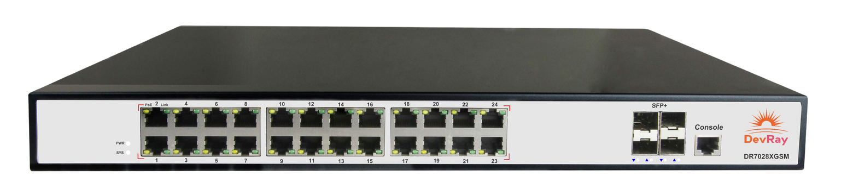
DR7000 series Enterprise Managed PoE Switch
DR7028XGSM
Features
Support L2+ Switching features including 802.1Q VLAN, Mirroring, IGMP Snooping, DHCP Snooping, LLDP, POE+ management, IP Source Guard, ARP inspection, ACL etc.
Support spanning tree STP(802.1D) and RSTP(802.1W) and MSTP(802.1s).
Support enhanced management through WEB, CLI, TELNET, SSH, SNMP.
Support cable diagnosis and SFP DDM.
Support PoE management, like PoE schedule,PoE PD-alive.
Support G.8032 quick ring protocol. Self-recovery time <20ms.
Support IEEE1588v2, transparent clock(TC)
Support IPV4 and IPV6 static routing functions
Support memory and CPU monitoring

Slide 37
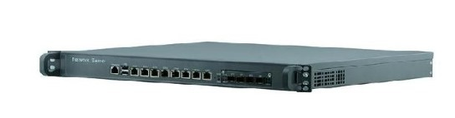
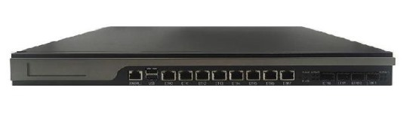
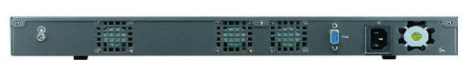
DevRay Firewall
Features
All-in-one Unified Security Gateway Threat Management Firewall
Intrusion Detection & Prevention
Multi WAN Uplinks
High Availability
Gateway Level Antivirus
Auto Failover and Load balance
Persistent Connectivity Next Generation Appliance Secure Access Productivity Assurance
Firewall
Intrusion Detection & Prevention
Multi WAN Uplinks
High Availability
Gateway Level Antivirus
Auto Failover and Load balance
Policy Based Routing
3G/4G USB Dongle/Tethering support
Gigabit Interface
Powerful Firewall Engines
Easy & User-Friendly GUI
IPsec VPN
Secure SSL VPN
Productivity Assurance
Hotspot Mgmt. / Body
Application Proxy (HTTP/HTTPS)
Anti-Spam
Web Content Filtering
QoS/ Bandwidth Management
Logging and real time monitoring
Anti Malware
Live View

Slide 38
CONTACT US!
PHONE
ADDRESS
EMAIL
0120-4971809
E-Block, E-29, 3rd Floor, Sector 63, Noida, Uttar Pradesh 201301
fly@maplecloudtecnologies.com

Slide 39

THANKS!
DO YOU HAVE ANY QUESTIONS?
Sales@Devray.in
+918178803636
www.devray.in
www.maplecloudtechnologies.com

